Slide 1
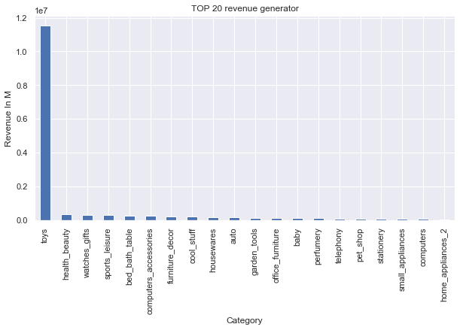
Top 10 revenue generated products
0 toys
1 health_beauty
2 watches_gifts
3 sports_leisure
4 bed_bath_table
5 computers_accessories
6 furniture_decor
7 cool_stuff
8 housewares
9 auto
10 garden_tools
11 office_furniture
12 baby
13 perfumery
14 telephony
15 pet_shop
16 stationery
17 small_appliances
18 computers
19 home_appliances_2

Slide 2
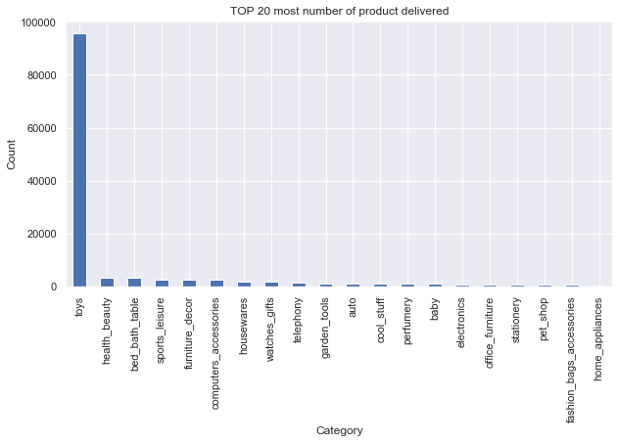
TOP 20 most number of product delivered
Product category | Order Count
Toys | 95727
Health_Beauty | 3389
Bed_Bath_Table | 3094
Sports_Leisure | 2641
Furniture_Decor | 2504
Computers_Accessories | 2461
Housewares | 1926
Watches_Gifts | 1685
Telephony | 1318
Garden_Tools | 1187
Auto | 1183
Cool_Stuff | 1070
Perfumery | 933
Baby | 873
Electronics | 762
Office_Furniture | 740
Stationery | 678
Pet_Shop | 556
Fashion_Bags_Accessories | 556
Home_Appliances | 308

Slide 3
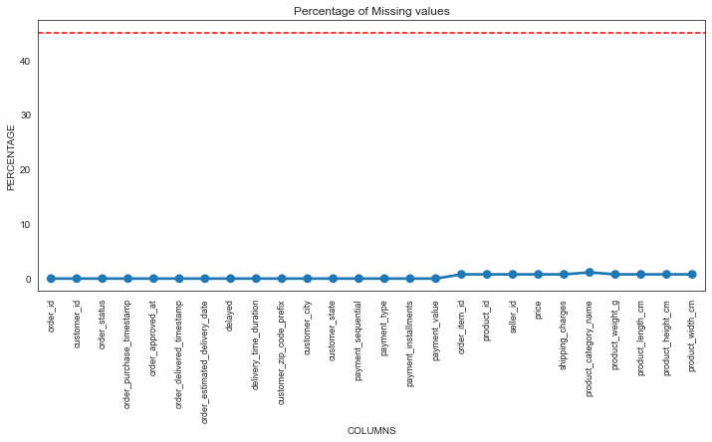
Percentage of Missing values
Strategy: Here we can see that all columns have below 45% of null value, so we don't have to drop them

Slide 4
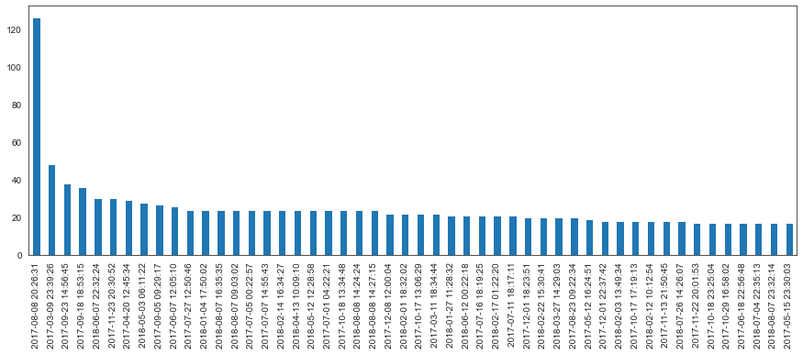
Order Purchase Timestamp
The growth of purchase from olist store within these years.

Slide 5
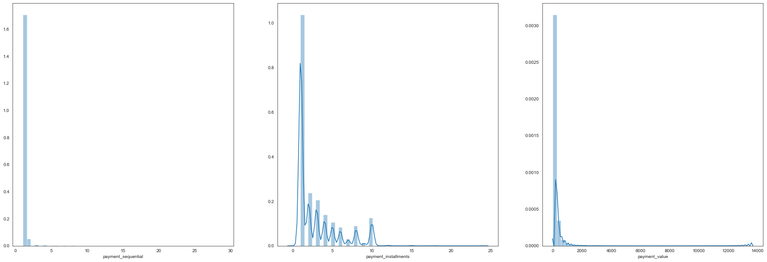
payment_sequential payment_installments payment_value

Slide 6
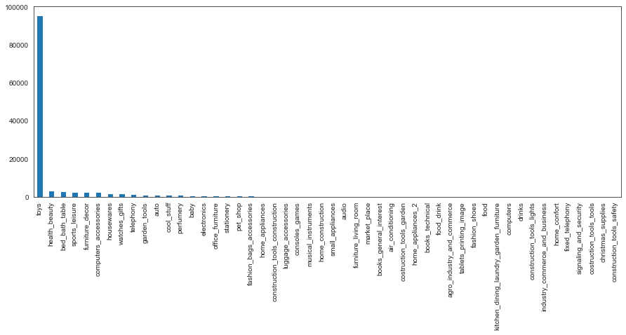
Final Order product category name
Insight 1:
The most common itemsets consist of a single item.
Insight 2:
There's a long tail of categories that consist of infrequently purchased items.

Slide 7
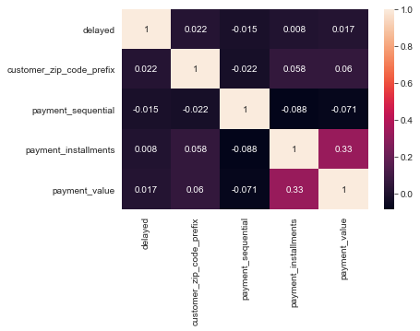
Order Pay Correlation between features

Slide 8
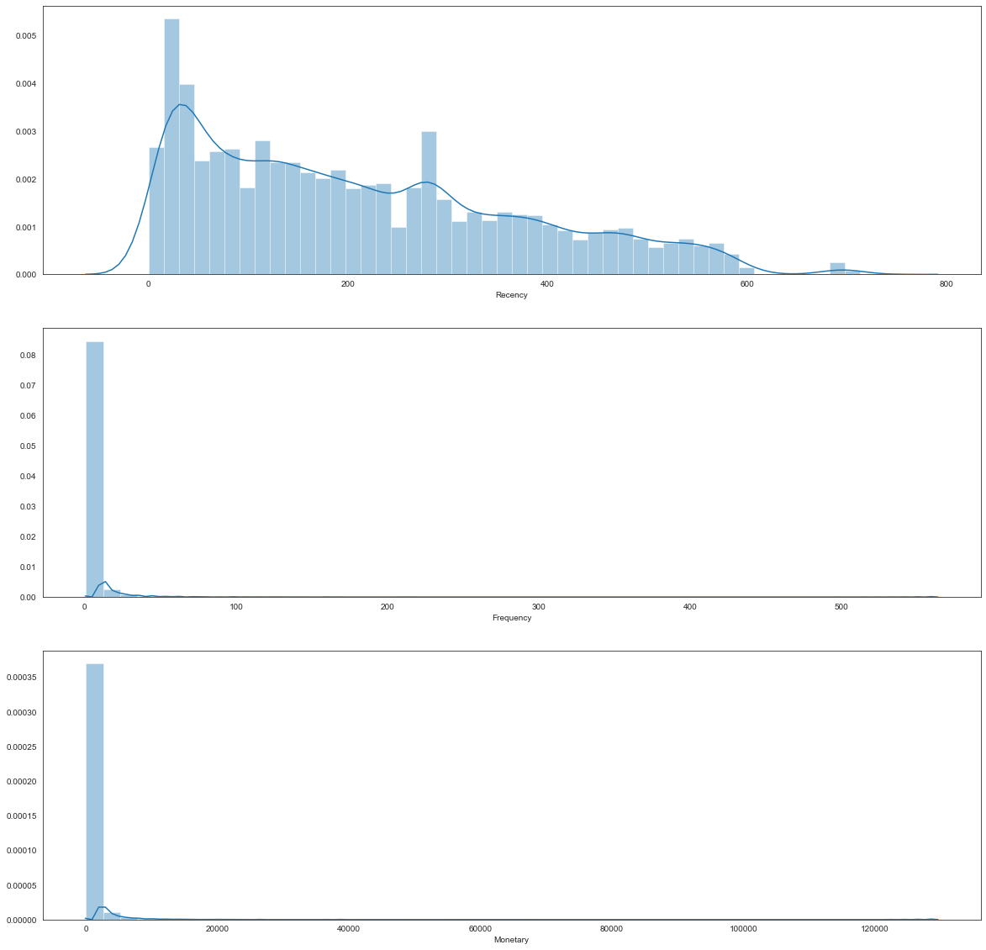
Plot RFM distribution
Insight - we can say that around 49% customers are one time customers and only 51% are recurring customers.

Slide 9
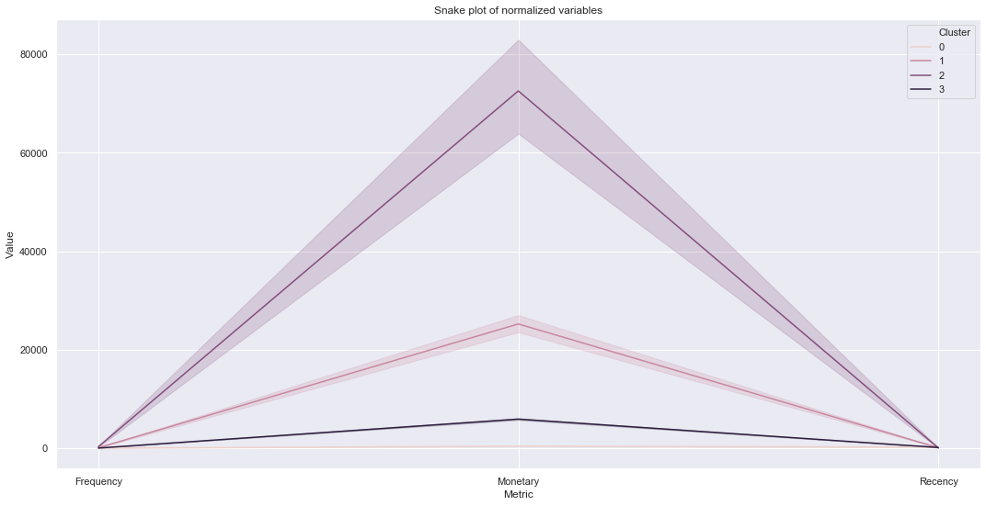
Relative Importance of RFM among K-Means Clusters
We can see that our grouped summary of the mean of R, F, M that each cluster of customers places a different emphasis on our 4 features:
Cluster 0
It has the highest MontaryValue mean and low Recency mean and the highest frequency mean — This is our ideal customer segment
Cluster 1
It performs poorly across R, F, and M. we will need to design campaigns to activate them again.
Cluster 2
They shopped with us recently but have not spend as much or as frequently as we would like them to — perhaps some personalization of products targeted at them can help to maximize their lifetime-value and come back to purchase?
Cluster 3
It has spent quite a fair amount with us but has not shopped with us in the 3–4 months — We will need to do something before we lose them!
Snake Plot

Slide 10
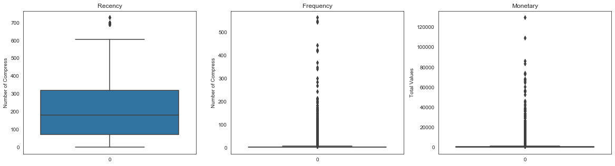
RFM segmentation
RFM Quartiles
The simples way to create customers segments from RFM model is to use quartiles.We assign score from 1 to 4 to Recency,Frequency and Monetary.4 is the best/heighest value, and 1 is the lowest/worst value. A RFM scoreis calculated simply by combining individual RFM score numbers.

Slide 11
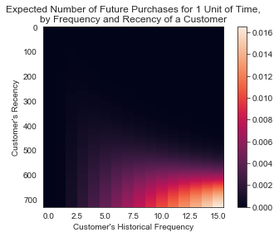
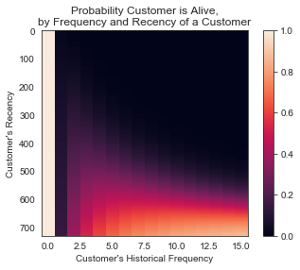
Plot frequency recency matrix
Plot probability alive matrix

Slide 12
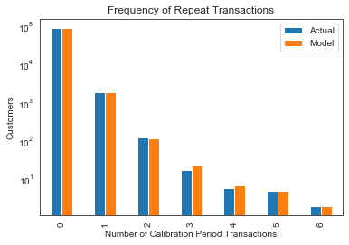
Plot Period Transactions
The model is fairly representative of the real data up until four repeat transactions. There are few customers who make more purchases.

Slide 13
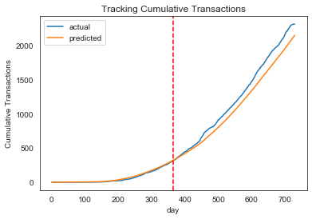
Cumulative Transaction Plot
The red line represents the boundary between the calibration period on the left and the holdout period on the right. As you can see, the BG/NBD model does a pretty swell job at predicting cumulative transactions.

Slide 14
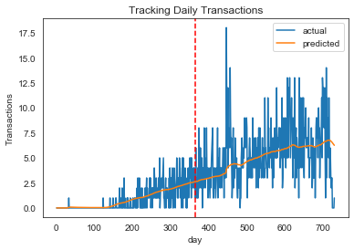
Incremental Transaction Plot
This plot shows that the model does a decent job capturing general trends in the data.

Slide 15
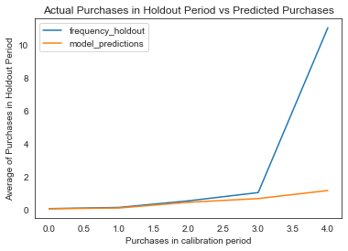
Conditional Expectations Plot
The model performs well up to three calibration period purchases, but diverges from the holdout data because of the distribution of the data.

Slide 16
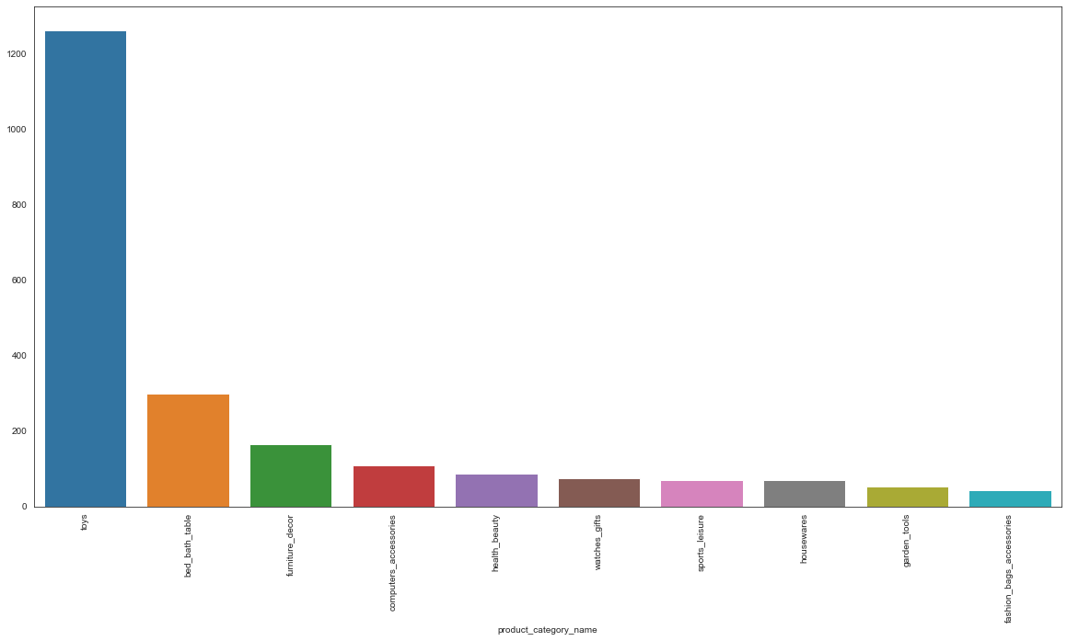
Top 10 items purchased freequently
Insight:-
The above mentioned graph shows 'Toys' which included 20% of the products range generates 80% of the revenue

Slide 17
Intuition we can get is that:
98% of transactions containing bed_bath_table also contain toys
24% of transactions containing toys also contain bed_bath_table
97% of transactions containing fashion_bags_accessories also contain toys There is more chance of the transaction {stationery,toys} or {telephony,toys} than other as we can find the interesting nature of rule by comparing lift,leverage and conviction. A rule is said to be interesting if it is unexpected(suprising to user) and/or actionable(user can do something with it).It's a subjective measure.
Conclusion
As per the analysis, below mentioned are the insights
Toys which holds 20% of the items generates 80% of the revenue
18.4 % of the customers are recurring, whereas 40% of the customers are either lost or on the verge of leaving. Thus we need to look at the core issues, what is leading to this loss.
30.5 % of the customers have joined recently, adding upto a good amount of revenue
Looking at the purchases, Tillnow the most revenue was generated in the month of Oct,2017 with the largest quantity of sales
Based on Aprirori, categorisation of products been done. Hence, leading to easy and structured access of products on the app
Using Kmeans, we worked on Expectation Maximization, giving a best case scenario of 4 in Recency, Frequency and Monetary
Frequency Holdouts are in better stage wrt to Model Predictions

